Slide 1

Developing a Model Organism to Investigate the Evolution of Cellular Differentiation
Baltazar Diaz
Mentor: Richard Michod
CoMentors: Erik Hanschen and Zach Grochau-Wright
University of Arizona

Slide 2
Cellular Differentiation
The evolution of multicellularity has occurred numerous times and this process is not completely understood
  The evolution of multicellularity underlies the evolution of large complex organisms such as animal and plants
Cellular differentiation allows for increase fitness through specialized cells
  Germ and somatic cells
Focusing on early transition of cellular differentiation
  How beneficial are somatic cells in the initial evolution of cellular differentiation

Slide 3
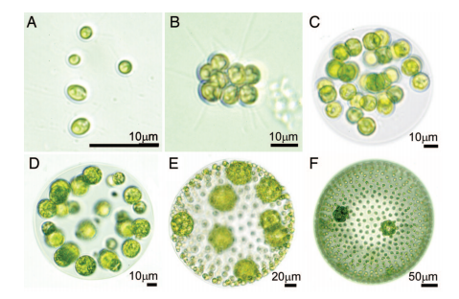
Background
Germ cell: cell involved in replication
Somatic cell: cell whose function is hypothesized to be involved in motility and nutrient gathering
Germ cell
Somatic cell

Slide 4
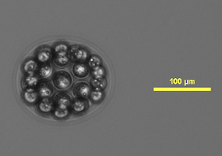
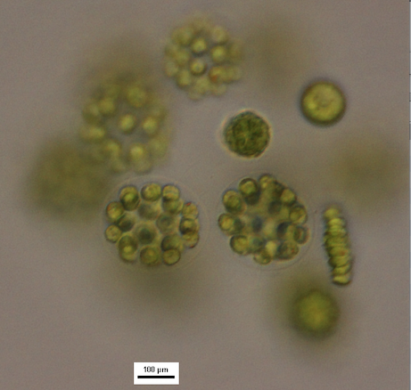
E. illinoisensis
Ranges from 4-32 cells
32 celled colonies had anterior cells reduced in size ( Goldstein 1964)
  Characterized as somatic cells
Somatic cells

Slide 5
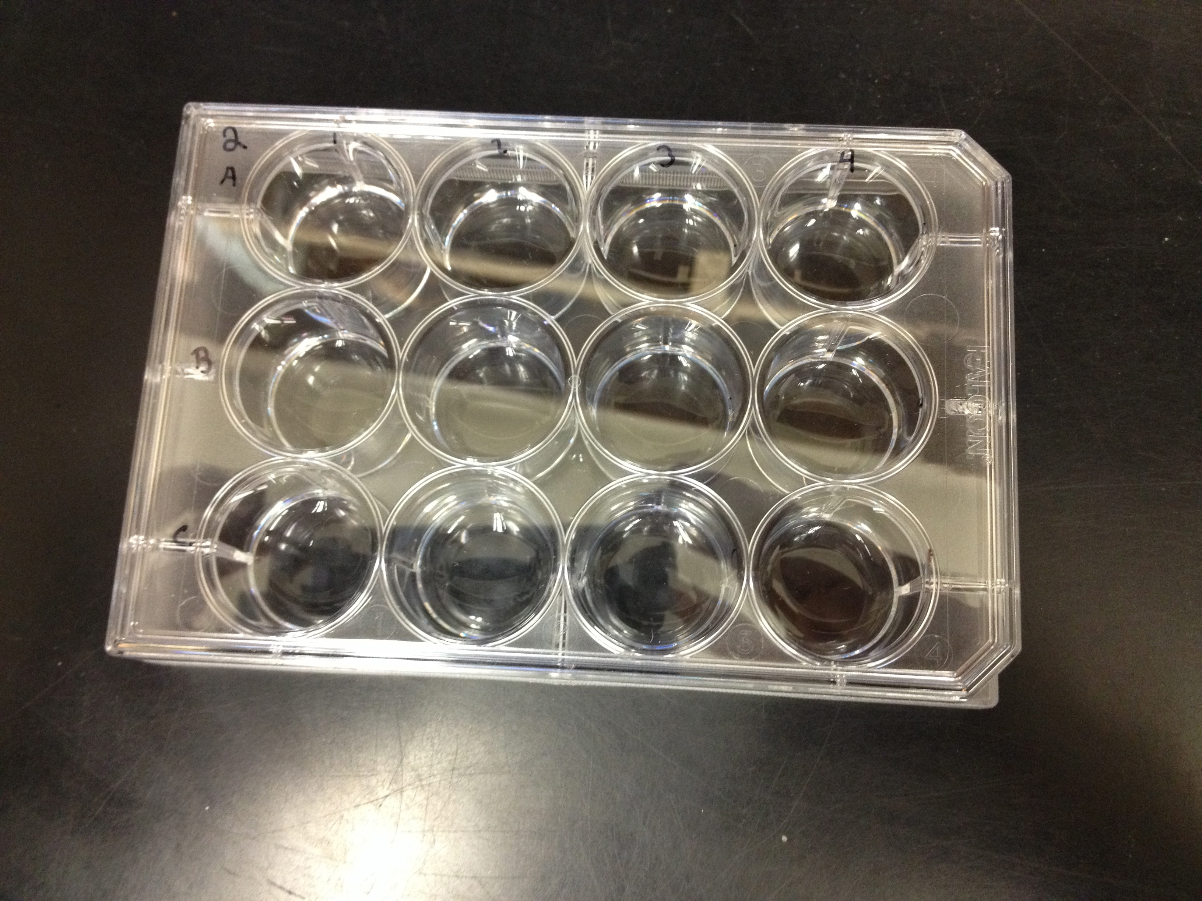
Methods
Developed protocol to decontaminate algae
Grew under optimum conditions
  1X SVM
Isolated after hatching and placed in 12 well plate
  Quantified after replication took place in well

Slide 6
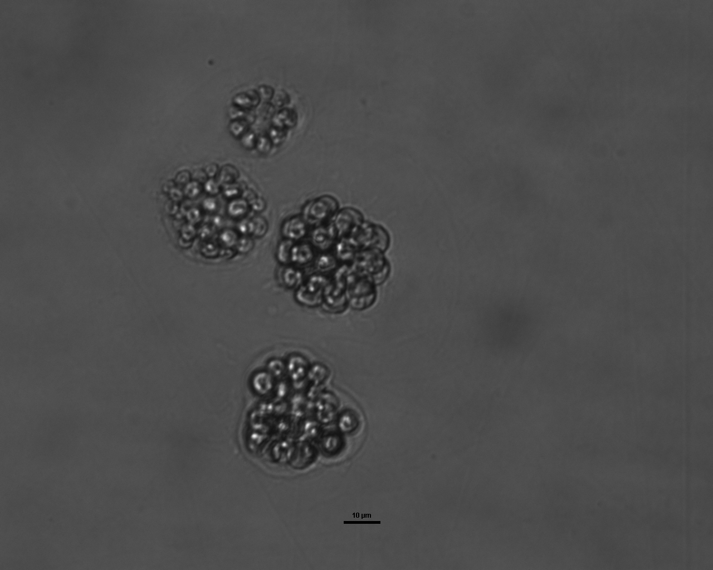
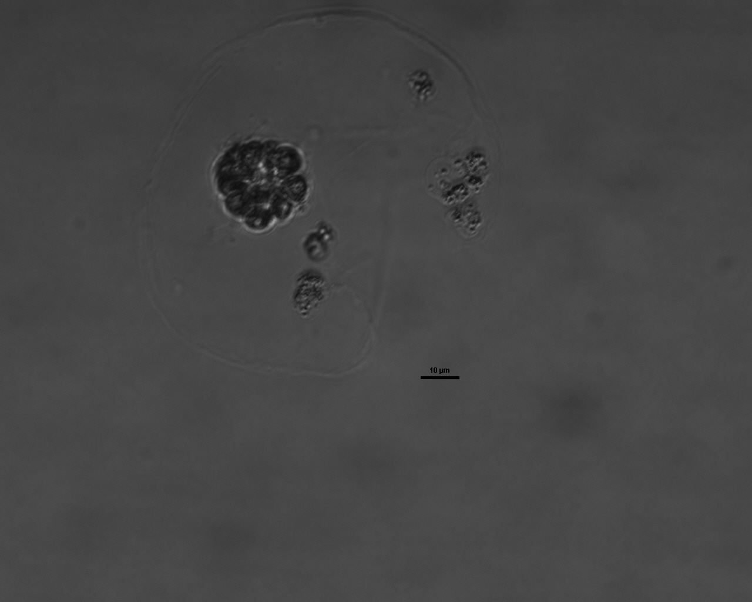
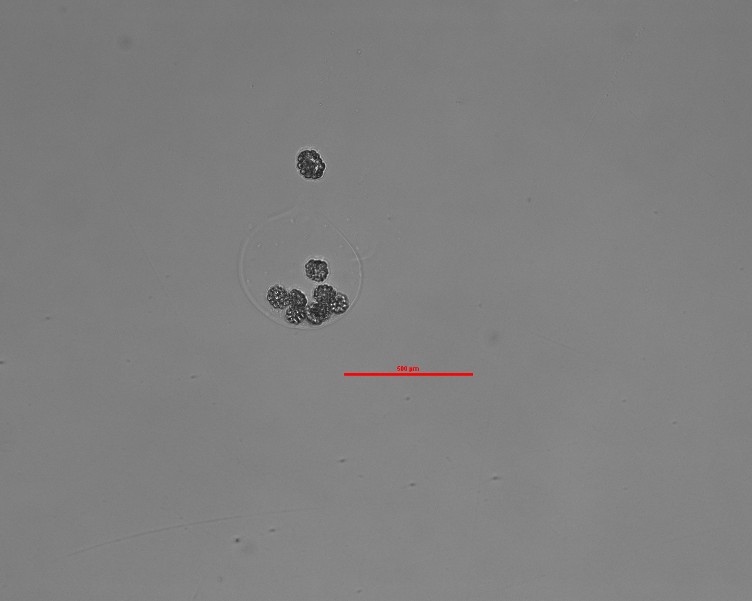
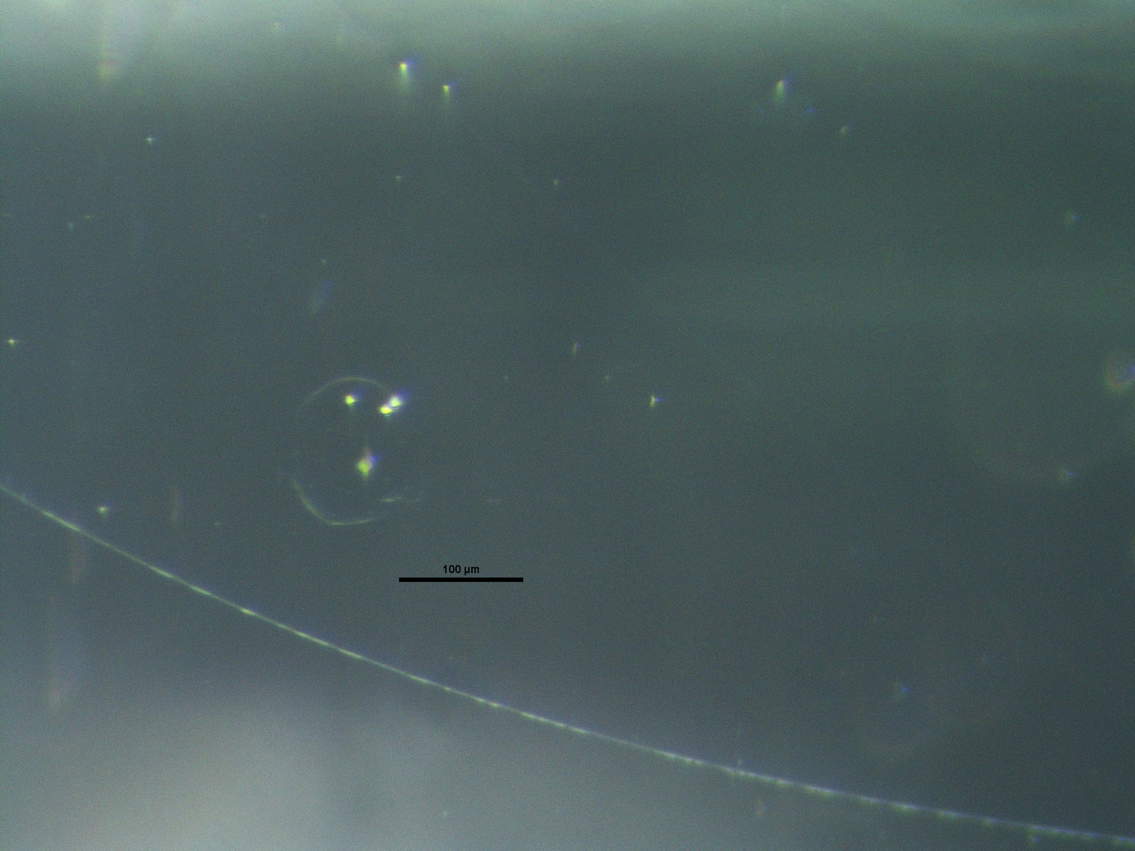
Quantification

Slide 7
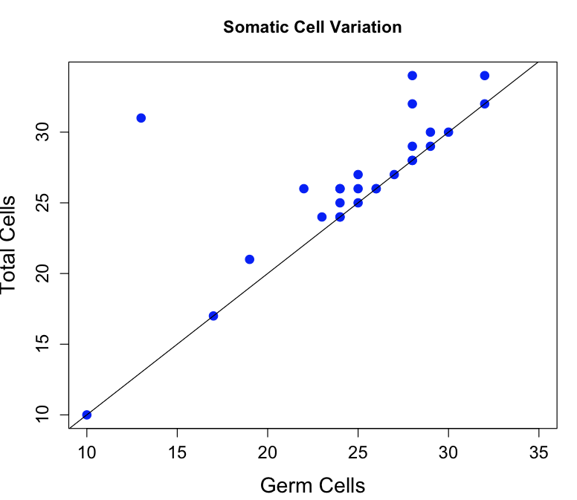
Results

Slide 8
Future Work
Grow in different conditions
  Source Sink Hypothesis (Koufopanou 1994)
    Phosphorus deprived media
    Nitrogen deprived media
  Motility Hypothesis (Herron 2006)
    Turbid environment

